Slide 1
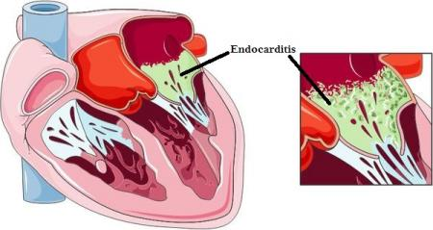
INFECTIVE ENDOCARDITIS
Dr. Dayasagar Rao V
DM(Cardiology) FRCP(Canada)
Sr Interventional Cardiologist
KIMS, Secunderabad

Slide 3
IE - Others
IE – Cardiac implant
IE – Cancer
IE - Marantic

Slide 4
IE - Development
Three stages
I. BACTEREMIA
Mouth
GI Tract
Urinary Tract
Skin
Venous catheter
Invasive
Surgery

Slide 5
II. ADHESION
Matrix Proteins
Adhesins
Fibrin & Platelets
Bacteria
Endocardium

Slide 6
III. COLONISATION
Cycles of Bacterial Proliferation
Recruitment of inflammatory cells
Produce BIOFILMS (Extracellular polysachride)
Protects :
Host immnue defect
Impedes antimicrobial efficacy
Protects resistant organisms

Slide 11
Diagnosis - IE
INFECTIVE
Blood Culture
ENDOCARDITIS
Occurrence New Valve lesions – MR / AR
Vegetations
Imaging
Embolic
Pathologic
Surgical

Slide 13
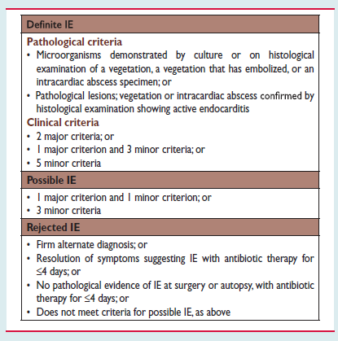
Definition Of Infective Endocarditis According To Modified DUKES Criteria

Slide 14
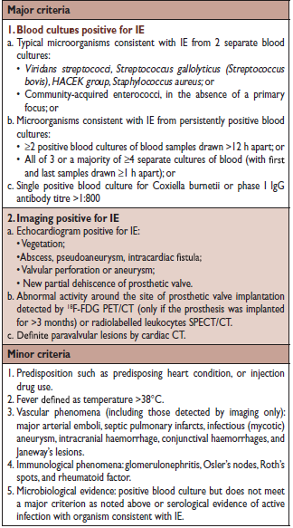
Definitions Of The Terms Used In The European Society Of Cardiology 2015 Modified Criteria For The Diagnosis Of Infective Endocarditis

Slide 18
IE – Microbiology – Blood Culture
10 –20% IE Blood Culture Negative
- Prevention Antibiotic usage
- Fastidious intracellular
- Fungi
- Alternate Diagnosis
I Stage
- Serologic Testing for Zoonotic Agents
- Coxiella
- Bartonella
- Brucella
- Myocoplasma
- Legionella

Slide 19
Serology
Positive
PCR
Targeting organism
Negative
Molecular Testing Bacterial
Ribosomal RNA genes
Negative
Autoimmune disease Marantic endocarditis

Slide 20
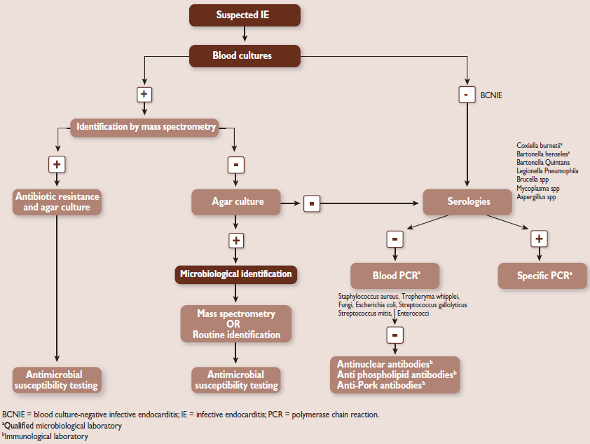
Microbiological diagnostic algorithm in culture – positive and culture negative IE

Slide 22
IE - Imaging
IMAGING
Diagnostic – vegetations
Complications – Perivalvular
Abscess
Aneurysm
Perforation
Fistulae
Valvular & ventricular function
Prognostic

Slide 23
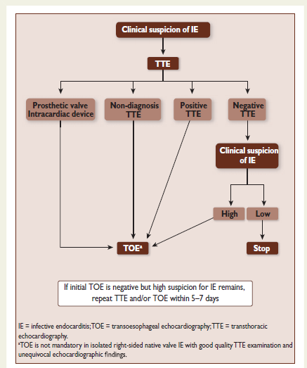
Indications for echocardiography in suspected infective endocarditis

Slide 24
IE - Imaging
Echo - TEE
- TTE
- RT 3DE
Native valve prosthetic valve
 |  | Sensitivity | Specificity
NVE | TTE | 90% | 90%
PVE |  | 40-70%
 | TTE | 90-100% | 90%

Slide 25
IE - Imaging
MSCT
- Higher sensitivity (than TEE) paravalvular – complications
- Aortic anatomy
- Coronary artery anatomy
Paravalvular lesion by MSCT- Major criteria ESC guidelines 2015

Slide 26
IE - MSCT
Defect complications of IE – Abscess
Pseudo aneurysm
Fistula
IE – Aortic valve , aortic anatomy size, calcification – Planning surgery
Non invasive imaging – CAD
Cerebral Angio – Mycotic aneurysm
MSCT with contrast – Abscess – Spleen / Abdomen

Slide 27
IE - MRI
MRI
BRAIN
NO neuro deficit/lesion
ABDOMEN
Therapeutic Strategy
Cerebral lesion
Timing of surgery
Ischemic lesion
Spleen perihepatic abscess
Minor criteria (DUKE)
Embolic consequences (micro bleed on MRI are NOT embolic)
Diagnostic Utility
NO definite IE
NO neuro symptoms (Minor criteria)

Slide 28
NUCLEAR IMAGING
F18 – FDG / CT :
Single acquisition point – usually 2hrs after 2hrs injection FDG
Taken up inflammatory cells
- leucocytes
- monocytes
- CD4 lymphocytes
Diagnostic utility
- Prosthetic valve IE
- Conduit infection
Monitor Response to therapy
- Device related IE (Pacemaker ICD/ CRT)

Slide 29
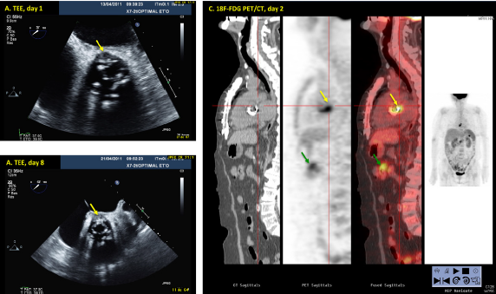

Slide 30
Imaging – Other organs (Brain / Abdomen)
Higher Incidence - Subclinical complications
- Embolism
- Abscess
- Hemorrhage
Routine CEREBRAL – MRI
abnormalities in 80 % patients with IE
One study upgraded 26% patients from “ Possible” to “ Definite” IE

Slide 31
MRI – Abdomen : Abnormalities : 34%
Spleen
Liver
Kidneys
E/O Embolism – Recognized
Novel MINOR
Criteria – DUKE
Disadvantages:
Post op inflammation – 3/12 false positive
Accessibility – facility

Slide 32
IE - Imaging
Metabolic Imaging
FDG – PET
PET – CT : sensitivity 73% ; specificity 80%
Increased Sensitivity Modified Duke criteria from 51% → 91%
Reclassification “ Possible IE” to definite IE : 95% cases
Positive signal at valvular site MAJOR criteria – ESC guidelines 2015.

Slide 33
Limitations
False positive first one month after cardiac surgery
Soft atheroma plaques (Aorta)
Vasculitis
Cardiac tumors – Primary
– Secondary

Slide 34
Nuclear Medicine - IE
Radiolabelled – WBC – SPECT / CT
More specific but lower spatial resolution
Blood handling for radiopharmaceutical preparations
Duration procedure – Long

Slide 35
CIEO - IE
Infection:
Least – PPI 1 – per 1000 device years
– CRT – ICD : 8 -9 per 1000 device years
Pocket
Lead
Endocardial Surface heart

Slide 36
IE – CIED Therapy
Mortality : In hospital :14.7%
One year :24%
Diagnosis:
Duke criteria – TEE
Metabolic Imaging
Inflammatory cell imaging
Duration Rx:
4-6 weeks appropriate Antibiotics
Transvenous Lead Extraction
Complications 3.5%
Reimplantation – Device
Contralateral side
14days after Sterile Blood Culture

Slide 37
CIED - IE
Procedure Factors
- Long Procedure Time
- Using > 2 leads
- Post – Op Hematoma
- Re – Intervention revision procedure: 2-5 fold higher risk
Diagnosis
- Blood culture
- TEE
- FDG -PET –CT
- False negative sensitivity : 30%
Therapy – Removal of Hardware

Slide 38
IE- Catheter Based Valvular Replacement - TAVR
High Risk – Surgery
Frail
Multiple Health Care Interventions

Slide 39
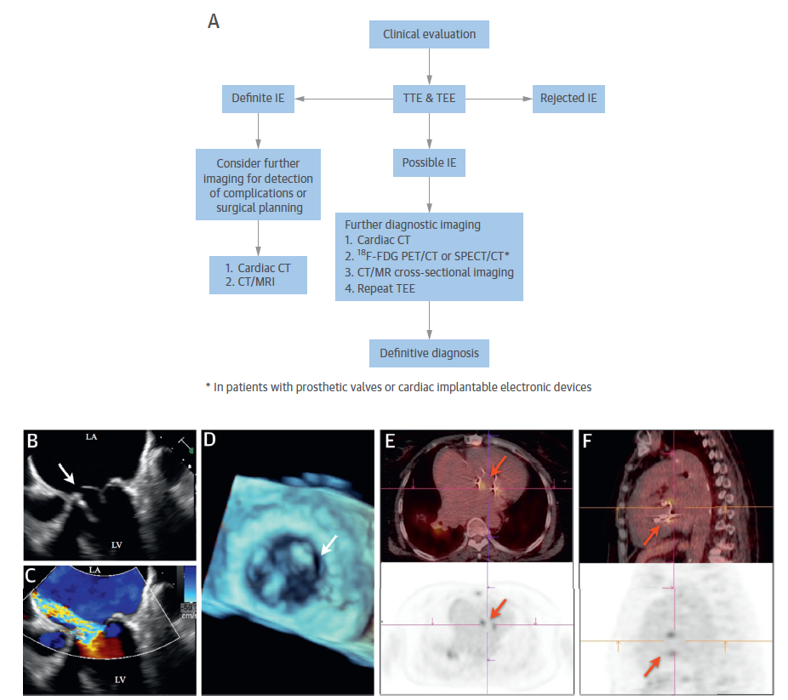
Integrated strategy in patients with suspected IE

Slide 40
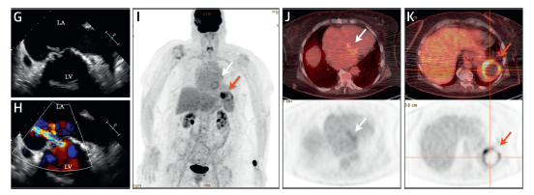

Slide 42
STROKE -IE
Embolic stroke – 20 – 40 % symptomatic (Asymptomatic)
Risk of Embolism
High – 1st week before Antibiotic 4.8per 1000pt.year
2nd week 1.71 per 1000
Prevention
Large vegetation >15
ESC : Class I: Surgery
Prevention of Recurrent embolism vegetation >10 class II (ACC/AHA)
Anticoagulants
Cardiac valve surgery – Timing after stroke?

Slide 43
CONCEPT OF IE -TEAM
ENDOCARDITIS TEAM
CARDILOGIST
IO Specialist
CARDIAC SURGEONS
NEUROLOGIST
Microbiologists
Imaging specialist
TOE
MSCT
MRI
Nuclear imaging
High level expertise
Higher level imaging –Multimodality
Cardiac Surgery
Complication of IE
Perivalvular abscess
Fistulae Etc

Slide 44
IE – Antibiotic Therapy
PRINCIPLES
Duration of Treatment :
NVE: 2 - 6weeks
PVE : more than 6 weeks
Amino glycosides
Recommendations have changed
Staph – NVE – No Aminoglycosides
Doubtful Benefits
Renal Toxicity
When used – Single Dose – IV
Cephalosporins instead of aminoglycosides

Slide 45
IE – Antibiotic Therapy
RIFAMPICIN
Foreign Body Infection
PVE
CEID
Add 3 -5 days after effective antibiotic therapy
DAPTOMYCIN
FOSFOMYCIN Staph IE
NETILMYCIN : Strep IE

Slide 46
IE – Antibiotic Therapy
BACTERICIDAL Drugs – In combination
Balancing efficacy with overall risk / toxicity
short course / stepped –down antibiotic
Penicillin / or ceftriaxone with aminoglycoside x2weeks safe and effective streptococci Viridans
Penicillin monotherapy / penicillin – Aminoglycoside – Staphylococcus aureus

Slide 47
Aminoglycoside + Penicillin - Strep Faecalis
Aminoglycoside – Deleted → High Resistance 25- 50%
Successful surgery + Negative culture for microbes on valve
Stop antibiotics x 2weeks (of therapy) ESC 2015
AHA/ACC – Continue drug x4weeks
Ampicillin + Ceftriaxone

Slide 48
IE – Antibiotics – step-down IV → ORAL
POET – Partial oral treatment of endocarditis
Danish trial – ONGOING
OPAT outpatient parenteral antibiotic therapy
2weeks → Aggressive IV therapy
Discharge → Low Risk Patients
2weeks → Outpatients PARENTRAL Antibiotic Therapy
Evolving Therapy
- Preventing Biofilm formation
- Disrupting Biofilm architecture
- Monoclonal Antibodies TRL 1068
-Daptomycin
10days IV Therapy

Slide 49
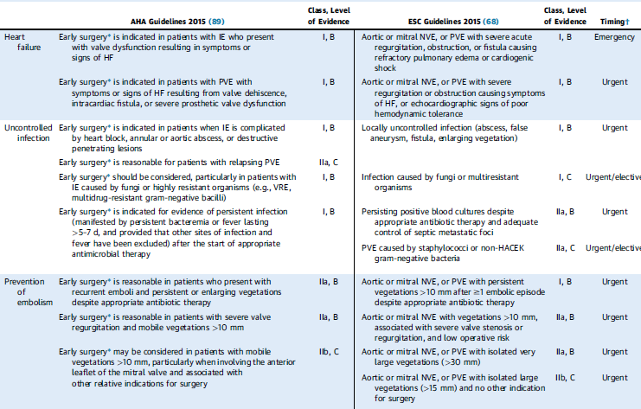
Indications of surgery in AHA and EC Guidelines

Slide 50
INFECTIVE ENDOCARDITIS
Restricted use of antibiotic for prevention of SBE
Risk of IE is related to
1. Cumulative, low grade Bacteremia during daily life
- Brushing
- Mastication
Rather than sporadic high grade bacteremia of procedure.
2. Risk of IE with antibiotic prophylaxis 1case IE per 150,000 dental procedure without antibiotics 1 case IE – per 46,000

Slide 51
Widespread usage results – emergence of resistant micro-organism
Risk of amphylaxis (in IV Administration)
Effect of antibiotics on Bacteremia and IE – No human trial, Animal trial only
Restriction of Antibiotics
- High risk of IE
- High risk of procedure (Bacteremia)
- Adverse outcomes of IE

Slide 52
High Risk – IE
THREE Categories
Prosthetic valve or prosthetic material used in valve repair
Previous H/o IE
Untreated cyanotic CHD
CHD – Post op palliative procedures (BT Shunt)
- Vascular conduits
- Prosthetic material repair of defects ASD/ USD – for 6/12
- Lifelong : Prosthetic material residual shunt or valvular regurgitation

Slide 53
IE – Prophylaxis -Antibiotics
HIGH RISK OF IE – Prosthetic material partially repaired
HIGH RISK OF PROCEDURE – Bacteremia
HIGH RISK ADVERSE OUTCOMES (Incase of IE)

Slide 54
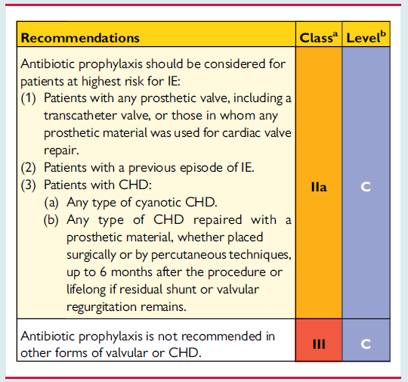
Cardiac conditions at highest risk of IE for which prophylaxis should be considered when a high – risk procedure is performed

Slide 55
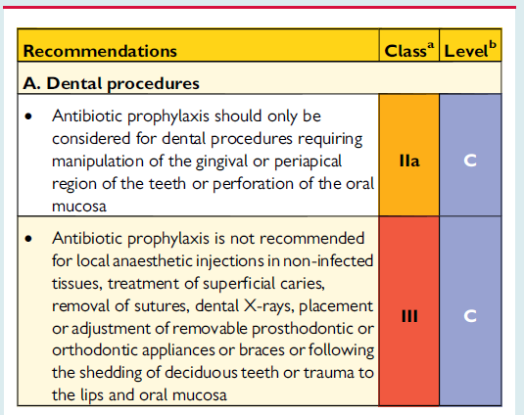
Recommendations for prophylaxis of infective endocarditis in the highest – risk patients according to the type of risk procedure

Slide 56
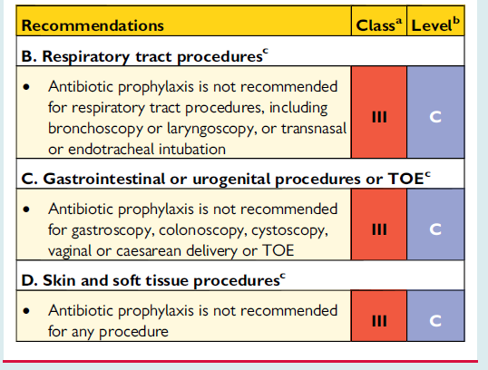

Slide 57
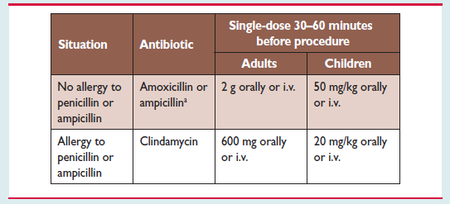
Recommendations prophylaxis for high – risk dental procedures in high – risk patients

Slide 58
IE – Prevention
No Antibiotics – Intermediate risk of IE
- Native valve decreased Bicuspid aortic valve MVPS. Calcifi AS
Dental and Skin hygiene – Patients
- Healthcare Workers

Slide 59
IE –Prophylaxis Body Piercing and tattooing
Discourage : Native valve disease
Prosthetic valve
If undertaken: Strict aseptic procedure
No antibiotic prophylaxis

Slide 60
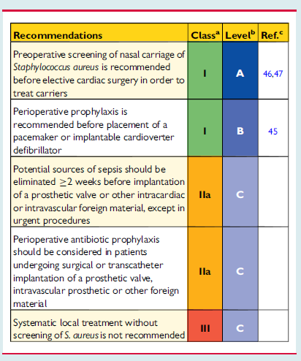
Recommendations for antibiotic prophylaxis for the prevention of local and systemic infections before cardiac or valvular interventions

Slide 61
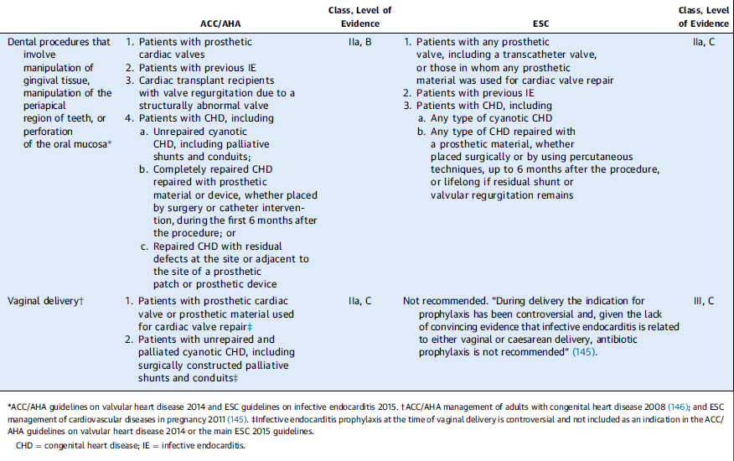
ACC/AHA Guidelines on use of Antibiotic prophylaxis for the prevention of IE

